Slide 1
Introduction to Distributed Systems

Slide 2
Contents in DS
Introduction to Distributed Systems.
Clocks & Causal ordering of messages.
Global snapshot, two algorithms for snapshots: Application-Deadlock detection.
Protocols: Balanced sliding-window & timer based Communication Protocols.
Routing Algorithms: Destination-based, All-pair shortest-path problem, Netchange, Compact routing tables, Hierarchical; Deadlock-free packet switching: Structured & Unstructured solution.
Fundamental Algorithms: Wave and Traversal Algorithms, Time Complexity using DFS, Election algorithms: Intro., Ring & Arbitrary networks, Korach-Kutten-Moran Algorithm.
Termination Detection: Computation Trees & Forests, Wave-based & Other
solutions.
Anonymous Networks: Deterministic & probabilistic algorithm, Computing the
network size.
Sense of Direction and Orientation: Intro. & Def^{n}., Election in & chordal rings, Computing in hypercubes, Complexity-related issues,
Synchrony in Networks: Election process, Synchronizer algorithm, Application-BFS, Archimedean assumption.
Dept. of IT, Jadavpur University

Slide 3
Some Basic Definitions
A program : is the code you write.
A process : is what you get when you run it.
A message : is used to communicate between processes.
A packet : is a fragment of a message that might travel on a wire.
A protocol : is a formal description of message formats and the rules that two processes must follow in order to exchange those messages.
A network : is the infrastructure that links computers, workstations, terminals, servers, etc. It consists of routers which are connected by communication links.
A component : can be a process or any piece of hardware required to run a process, support communications between processes, store data, etc.

Slide 4
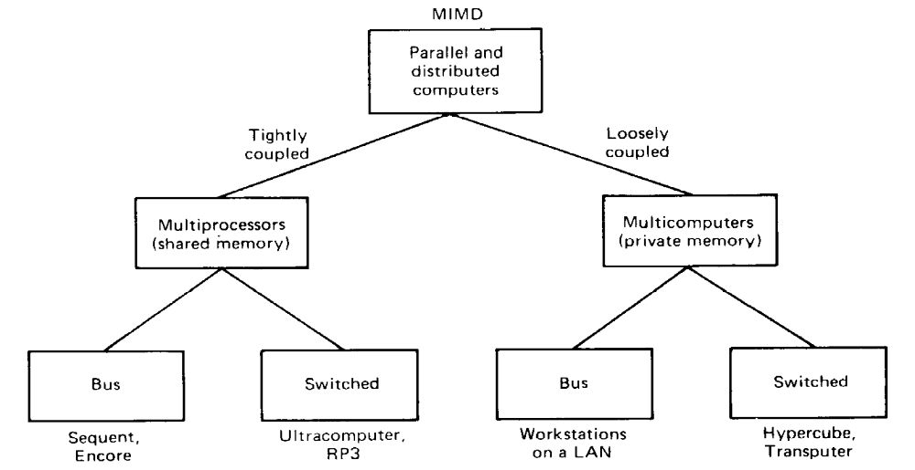
Computer architecture: TCS & LCS [1 0f 2]
Multiprocessors- Shared memory
Multicomputers- own private memory
Essential difference- Single virtual address space that is shared by all CPUs.

Slide 5
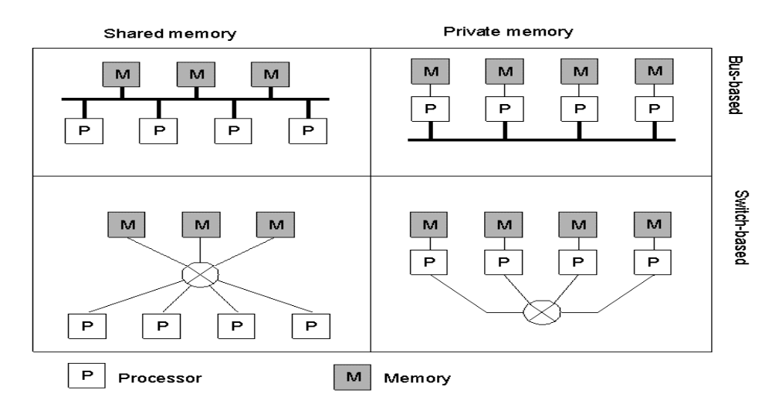
Computer architecture: TCS & LCS [2 0f 2]
TCS : Single Systemwide primary memory (address space) shared by multiple processors.

Slide 6
LCS: Processors do not share memory, each processor has its own local memory.
TCS are referred as Paralleling processing System
LCS are referred as Distributed system

Slide 7
Distributed System
A distributed system is a collection of independent processes that executes a collection of tasks to coordinate the actions of multiple protocols on a network, such that all components cooperate together to perform a single or small set of related tasks and appears to its users as a single coherent system.
Two aspects:
1) Autonomous computers &
2) Appeared to be a single system (i.e., collaboration is required )
Dept. of IT, Jadavpur University

Slide 8
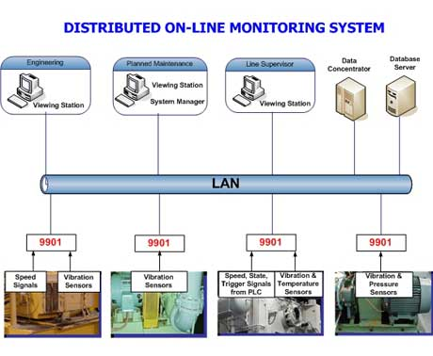
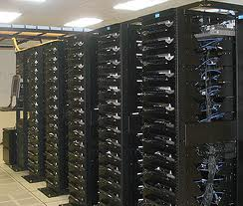
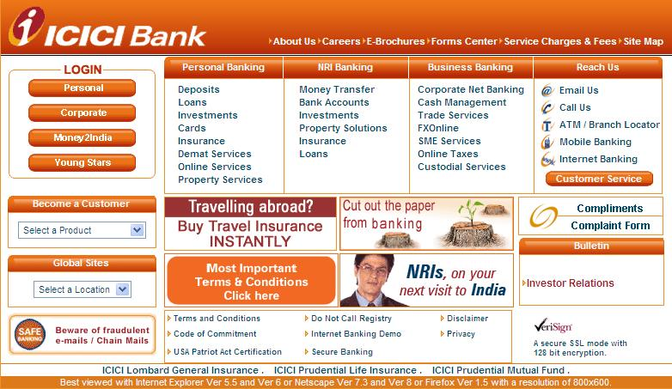

Distributed systems
Google Server Cluster
Dept. of IT, Jadavpur University

Slide 9
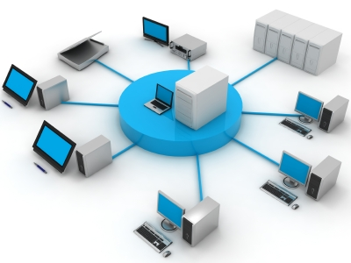
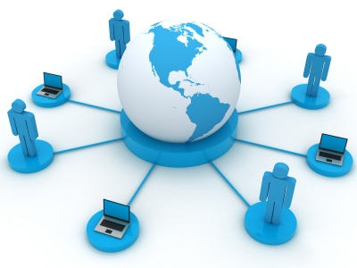
Networks
ARPANET established in 1969
Term “Internet” came into use since late 1980s
Dept. of IT, Jadavpur University

Slide 10
Common Features of Distributed Systems
Differences between the various computers and the ways in which they communicate are mostly hidden from users.
Users and applications can interact with a distributed system in a consistent and uniform way, regardless of where and when interaction takes place.

Slide 11
Why build a distributed system ?
The ability to connect remote users with remote resources in an open and scalable way.
Open, we mean each component is continually open to interaction with other components –Open Distributed Systems
Scalable, we mean the system can easily be altered to accommodate changes in the number of users, resources and computing entities.

Slide 12
Why are DCSs are gaining popularity?
• Resource and Information Sharing
• Higher Throughput
• Fault Tolerance
• Scalability
Inherently Distributed Applications
Better Price-Performance ratio

Slide 13
Issues to handled:
– Un-reliability of communication
– Lack of global knowledge
– Lack of synchronization and causal ordering
– Managing a large Number of Distributed Resources
– Concurrency control
– Failure and recovery

Slide 14
DS must have the following characteristics:
Fault-Tolerant: It can recover from component failures without performing incorrect actions.
Highly Available: It can restore operations, permitting it to resume providing services even when some components have failed.
Recoverable: Failed components can restart themselves and rejoin the system, after the cause of failure has been repaired.
Consistent: The system can coordinate actions by multiple components often in the presence of concurrency and failure. This underlies the ability of a distributed system to act like a non-distributed system.

Slide 15
Scalable: It can operate correctly even as some aspect of the system is scaled to a larger size. For example, we might increase the size of the network similarly, we might increase the number of users or servers. In a scalable system, this should not have a significant effect.
Predictable Performance: The ability to provide desired responsiveness in a timely manner.
Secure: The system authenticates access to data and services

Slide 16
Design a distributed system with "8 Fallacies"
The network is reliable.
Latency is zero.
Bandwidth is infinite.
The network is secure.
Topology doesn't change.
Transport cost is zero.
The network is homogeneous.
There is one administrator.

Slide 17
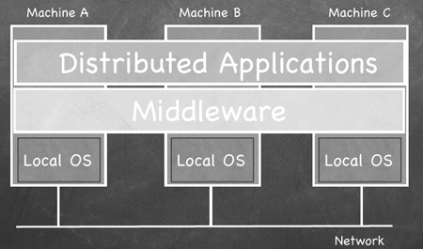
Organization of a distributed system
To support heterogeneous computers and networks while offering a single system view, distributed systems are often organized by means of a layer of software between a higher layer of users and applications and a lower layer of operating systems. Such a distributed system is called a middleware.
Dept. of IT, Jadavpur University

Slide 18
Goals of a distributed system
Connecting users and resources
Transparency
Openness
Scalability
Dept. of IT, Jadavpur University

Slide 19
Connecting users and resources
Resources: Printers, computers, data, files, Web pages etc.
Connecting users and resources makes it easier to collaborate and exchange information
Internet has enabled development of open source community, e-commerce, etc.
Security issues:
  Password theft
  Tracking communication to build personal profile of a specific user
  Spam (i.e., electronic junk mail)
Dept. of IT, Jadavpur University

Slide 20
Transparency
Make the existence of multiple computer invisible and provide a single system image to its users.
Hide the fact that the resources are physically distributed across multiple computers.
The NINE forms of transparency identified by ISO’s “Reference Model for open Distributed Processing”.
Dept. of IT, Jadavpur University

Slide 21
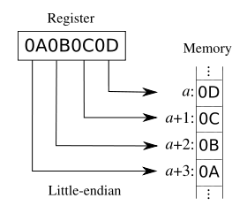
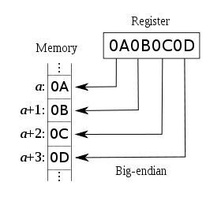
1. Access transparency
Distributed os should allow the user to access remote resources in the same way as local resources.
Hide differences in data representation and how a resource is accessed.
Dept. of IT, Jadavpur University

Slide 22

2. Location transparency
Name transparency : The name of a resource should not reveal any hint as to the physical location of the resource. Resources must be able to move from one node to another and thus the names must be unique system wide. Hence, resources must have logical name.
User Mobility: No matter into which machine a user is logged in he should be able to access a resource with the same name.
Dept. of IT, Jadavpur University

Slide 23
3. Replication transparency
Resources can be replicated
  to increase availability
  to improve performance by placing a copy close to the place from where it is accessed
Replication transparency hides the fact that several copies of a resource exist.
Generally replication transparency => location transparency
Dept. of IT, Jadavpur University

Slide 24
4. Relocation transparency
Resource may move from one node to another while in use.
e.g., Users can move with wireless phone from one place to another with seamless connectivity.

Slide 25
5. Failure transparency
Masks from users’ partial failure in the system such as link failure, m/c failure, storage device crash etc.
Issue:
  It is difficult to achieve since it is hard to distinguish between a dead resource and a painfully slow resource.
N.B.: There is also usually a trade-off between achieving a high
level of failure transparency and maintaining an adequate
level of system performance.
Dept. of IT, Jadavpur University

Slide 26
6. Migration transparency
Migration decisions should be made automatically by the system.
Migration of an object from one node to another should not require any change in name.
When the migrating object is a process, the inter process communication should ensure that a message sent to the migrating process reaches it without the need for the sender process to resend it if the receiver process moves to another node before the message is received.
N.B.: Data migration can be achieved by using AFS or NFS
Dept. of IT, Jadavpur University

Slide 27
7. Concurrency transparency
i) Event –Ordering Property
ii) A mutual exclusion property
iii) A no- starvation property
iv) A no-deadlock property
Dept. of IT, Jadavpur University

Slide 28
8. Performance transparency
Allow the system to automatically reconfigure to improve performance.
Dept. of IT, Jadavpur University

Slide 29
9. Scaling transparency
Allow the system to expand in scale without disrupting the activities of the users.
Calls for open-system architecture and the use of scalable algorithms for designing DS os components.
Dept. of IT, Jadavpur University

Slide 30
Scalability
3 dimensions:
  Size: We can easily add new users and resources to the system
  Geography: Users and resources may lie far apart
  Administrative domain: The distributed system is easy to manage even if it spans many independent administrative organizations
Dept. of IT, Jadavpur University

Slide 31
Scaling problems [1 of 3]
Scaling w.r.t. Size:
  In a single server and multiple clients, server is overloaded
  Single server is sometimes unavoidable such as when it stores confidential information.
  Features of decentralized algorithms:
    No machine has complete information about the system state
    Machines make decisions based on local information
    Failure of one machine does not ruin the algorithm
    There is no implicit assumption that a global clock exists
Dept. of IT, Jadavpur University

Slide 32
Scaling problems [2 of 3]
Scaling w.r.t. Geography:
  Many distributed systems designed for LANs are based on synchronous communication. This leads to unacceptable delay for wide area systems.
  Local area communication is generally reliable and supports broadcasting. Wide area communication is inherently unreliable and virtually always point-to-point. Hence service query is easier in LAN. Needs special location service in WAN.
  Centralized services hinder geographical scalability.
    Example: A central mail server for an entire country.
Dept. of IT, Jadavpur University

Slide 33
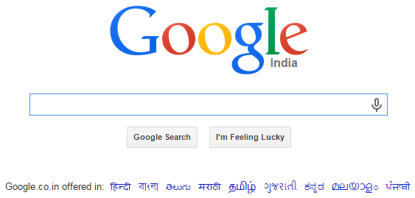
Scaling problems [3 of 3]
Scaling w.r.t. Administrative Domains:
  Conflicting policies regarding resource usage (and payment), management and security.
Dept. of IT, Jadavpur University

Slide 34
Guiding Principles for designing scalable DS
Avoid Centralized Entities: Data and services
Avoid centralized Algorithms: E.g. Centralized scheduling algorithms.
Perform most operations on client workstations

Slide 35
Scaling techniques [1 of 2]
Main issue is the limited capacity of servers and network
Solutions:
  Hiding communication latency
    Asynchronous communication: Suitable for batch processing systems and parallel processing
    Client-server distribution: Divide tasks effectively; suitable for interactive applications like Web-based form entry
  Distribution
    Split each component into smaller parts and spread those parts across the system
    Example: In WWW, documents are distributed across several servers
Dept. of IT, Jadavpur University

Slide 36
Scaling techniques [2 of 2]
  Replication
    Replicate components across a distributed system
    Increases availability, distributes load well, increases performance if local copy is used
    Special case:
      Caching:
        Store copy of a resource close to client.
        Decision made by client while in replication it is made by resource owner
    Consistency problem: Modifying one copy makes it different from the rest.
    Tolerance:
      Web users normally find a cached web page (whose validity has not been checked for last few minutes) acceptable.
      In an electronic transaction, the update must be immediately propagated to all copies.
Dept. of IT, Jadavpur University

Slide 37
Openness [1 of 3]
Open distributed system: Offers services according to standard rules that describe the syntax and semantics of those services
Services are specified through interfaces described in an Interface Definition Language (IDL)
Interface definitions in IDL specify only syntax
Semantics are normally specified in natural language
Dept. of IT, Jadavpur University

Slide 38
Openness [2 of 3]
Proper specifications are
  Complete: Sufficient to make an implementation
  Neutral: Do not specify how an implementation looks like
Completeness and neutrality help in
  Interoperability: Multiple implementations from different vendors can coexist and work together by relying on services specified by a common standard
  Portability: An application developed for a distributed system A can be executed, without modification, on a different distributed system B that implements the same interface as A
Dept. of IT, Jadavpur University

Slide 39
Openness [3 of 3]
Flexibility
  Easy to configure a distributed system out of different components possibly from different vendors
Extensible
  Easy to add new components without affecting those that stay in place
Dept. of IT, Jadavpur University

Slide 40
Degree of transparency
Distribution transparency not always recommended:
  Suppose a user receives e-newspaper by 7 am local time. User moves to a new time zone. Then user must communicate this information.
  Network delays are sometimes appreciable and needs to be communicated to the users
  Many Internet applications retry a connection several times before finally giving up. This may slow down the system
  Maintaining consistency among several distributed replicas may increase the time cost of an update operation
Dept. of IT, Jadavpur University

Slide 41
Distributed System failures
Failure falls in two categories:
    Hardware:
    Software:
  Hardware failures were a dominant concern until the late 80's, but since then internal hardware reliability has improved enormously.
  Decreased heat production and power consumption of smaller circuits, reduction of off-chip connections and wiring, and high-quality manufacturing techniques have all played a positive role in improving hardware reliability.

Slide 42
Software Failures
Software failures
Heisenbug
Bohrbug
Halting failures
Fail-stop
Byzantine failures
Omission failures
Network partition failure
Timing failures

Slide 43
Separating policy from mechanism
In a flexible open distributed system, user should be able to specify his preferences/policies to be used by mechanisms of the system to customize the system for the user
Example:
  A web browser should only store documents and allow users to specify preferences like which documents to store and for how long
Dept. of IT, Jadavpur University

Slide 44
Hardware concepts
Multiprocessors
  Shared memories
  Always homogeneous
  Types of interfacing between processors and memories
    Bus-based or switch-based
Multi-computers
  Only local memory
  Homogeneous / heterogeneous
  Types of interfacing between computers
    Bus-based or switch-based
Dept. of IT, Jadavpur University

Slide 45
Interconnections
In a bus interconnection system, there is a single network, backplane, bus, cable, or any other medium that connects all the machines.
  Example: Cable television network
Switched systems do not have a single backbone. A switching matrix maps a set of inputs to a set of outputs.
  World wide public telephone system
  In shared memory multiprocessors, switching is done to map processors to memories.
Dept. of IT, Jadavpur University

Slide 46
Software concepts
Operating systems for distributed systems have 2 main goals:
  They act as resource managers for the underlying hardware, allowing multiple users and applications to share resources like CPUs, memories, peripheral devices, the network and data of all kinds.
  They attempt to hide the intricacies and heterogeneous nature of the underlying hardware by providing a virtual machine on which the applications can be easily executed.
Dept. of IT, Jadavpur University

Slide 47
OS for distributed systems [1 of 3]
Distributed Operating Systems (DOS):
  Users access remote resources in the same way they access local resources. Three types of migration:
  Data migration, Computational migration and Process migration
  Tightly-coupled OS (Acting as virtual uniprocessor)
  Tries to maintain a single, global view of the resources it manages
  Used for managing multiprocessors and homogeneous multicomputers
  Dynamically and automatically allocates job to various machines
Dept. of IT, Jadavpur University

Slide 48
OS for distributed systems [2 of 3]
Network Operating Systems (DOS):
  Users are aware of multiplicity of machines, can access remote resources by either logging in to the appropriate remote machine or transferring data from the remote machine to their own machine
  Loosely-coupled OS
  Makes local services available to remote clients
  Used for managing heterogeneous multicomputer systems
  To provide better distribution transparency to distributed applications, enhancements to the services of NOS in the form of middleware are needed

Slide 49
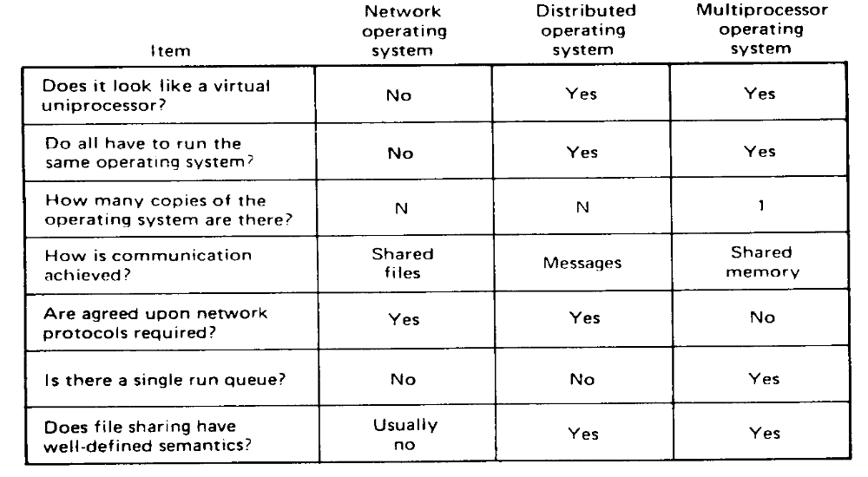
OS for distributed systems [3 of 3]
Difference between three kind of systems on n CPUs

Slide 50
Types of Distributed Systems
  Distributed Computing System
  - Cluster Computing System
  - Grid Computing System
  Distributed Information System
  - Transaction Processing System
  Distributed Pervasive Systems
  - Home Systems
  - Electronic Health Care Systems
  - Sensor Networks

Slide 51
Reference Books:
1. Advanced Concepts in Operating Systems By Mukesh Singhal and Niranjan G. Shivaratri –McGraw Hill International Edition
2. Introduction to Distributed Algorithms By Gerard Tel – Cambridge University Press
3. Distributed Operating Systems Concepts and Design By Pradeep K.Sinha – PHI
4. Distributed Operating Systems Concepts and Design By George Colours, Jean Dollimore, Tim Kindberg – Pearson Education

